Slide 1
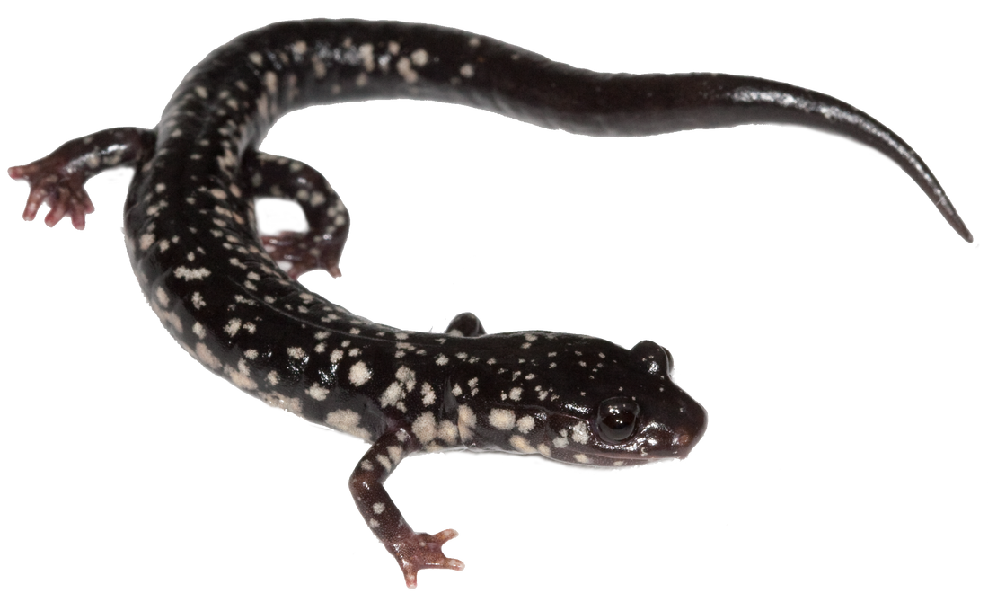
Evolutionary Transitions of a Discrete Trait
LunchinatoRs
April 6, 2018
Erica Baken

Slide 2
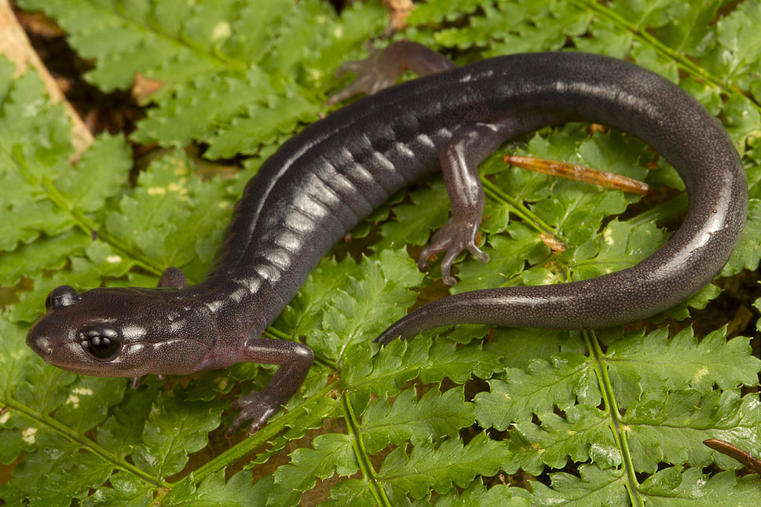
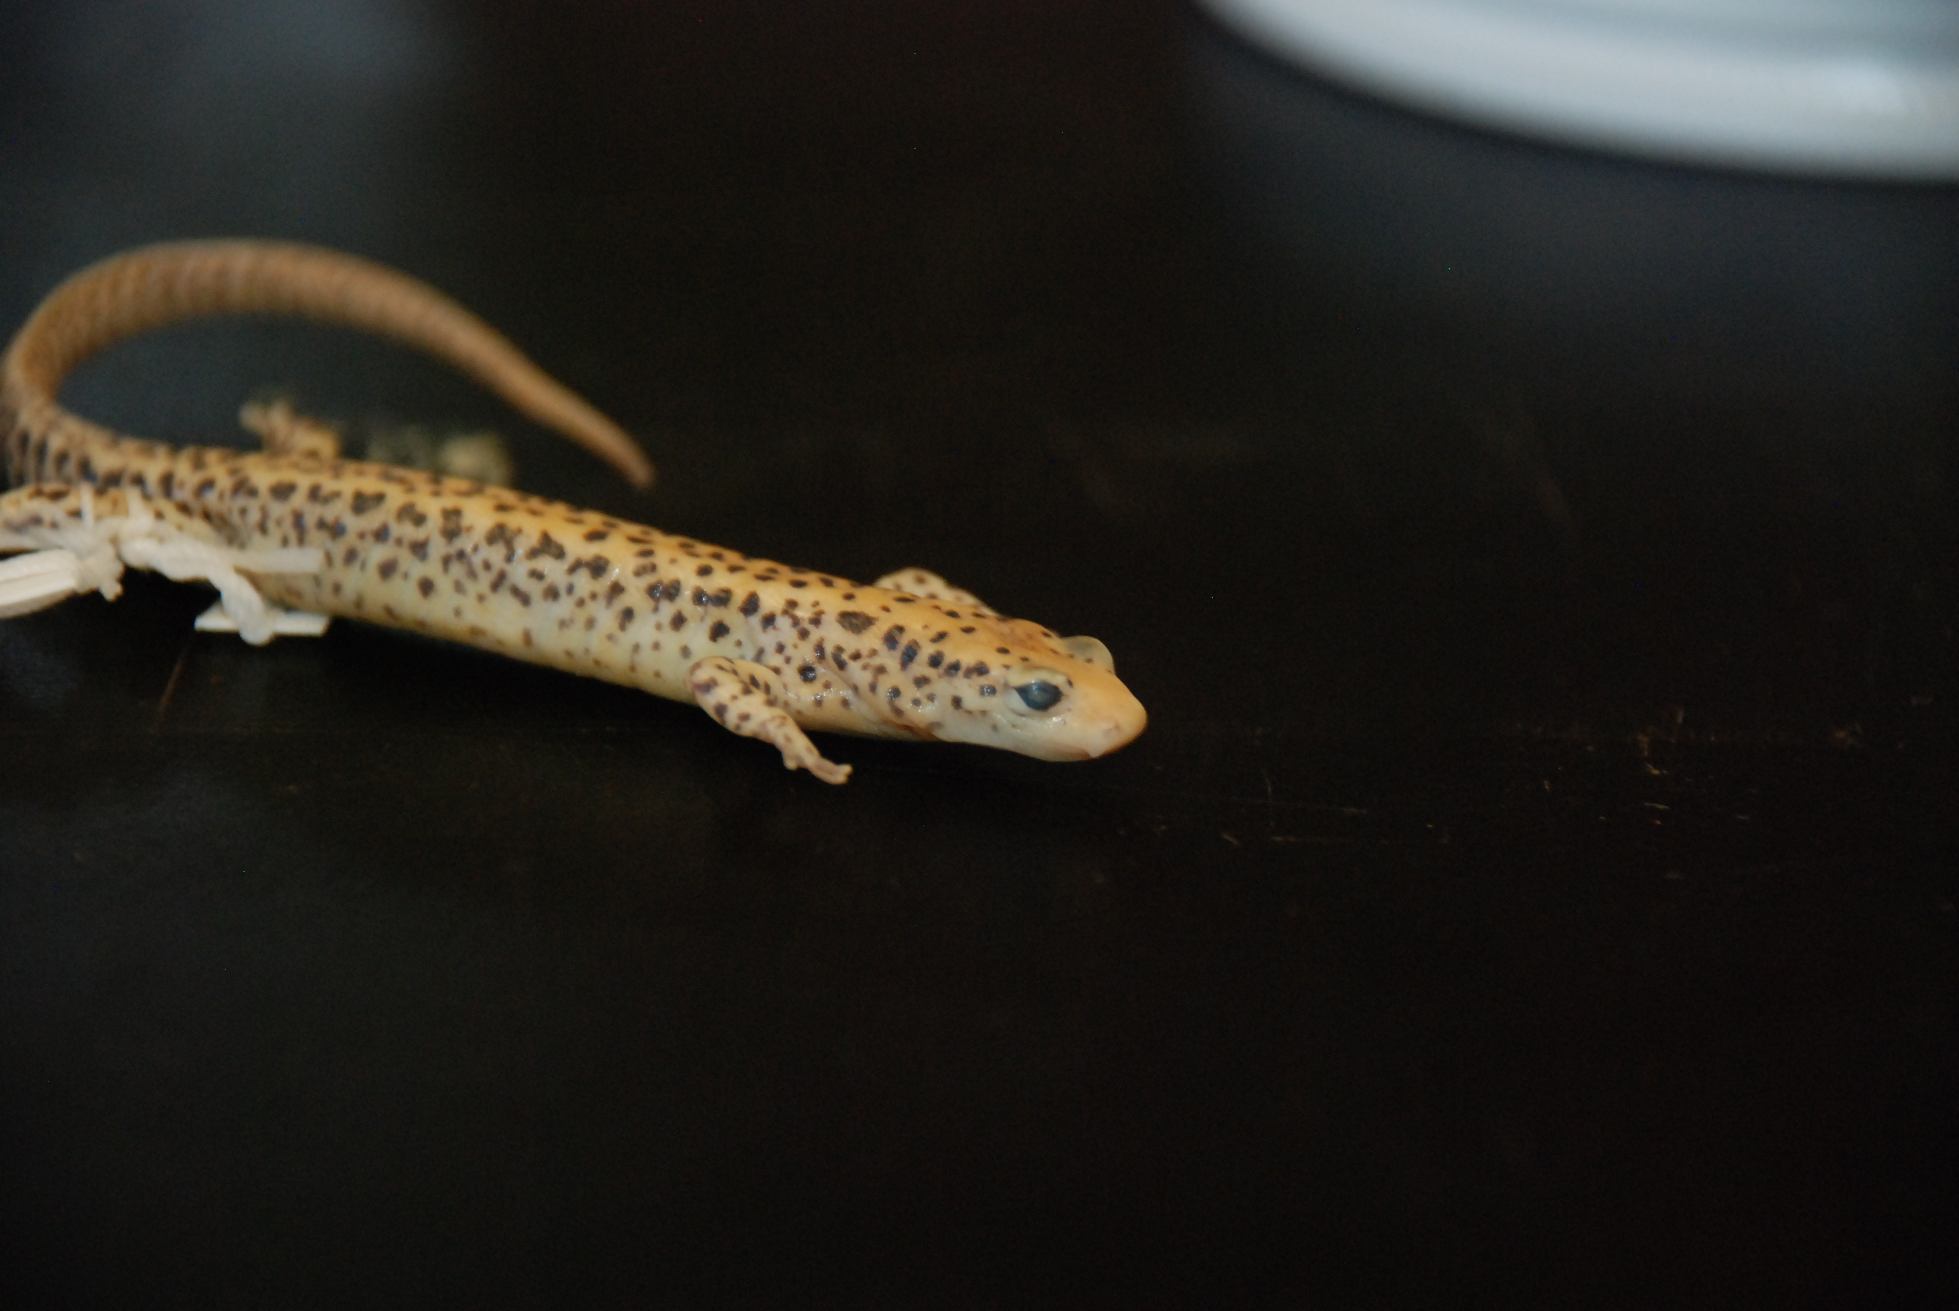
Main Question
How does a salamander become arboreal?
How many times has it happened?
Are there eco-evolutionary limitations to these transitions?
Which types of salamanders have done it?

Slide 3
Many methods for this type of question
Parsimony 😐
Ancestral State Reconstruction
Maximum Likelihood – ape package
Majority Rule
Stochastic Mapping
Simulation Based – simmap package
Single Rate Matrix
Reverse Jump MCMC
BayesTraits – through terminal
Hidden Markov Model
Model Comparison – corHMM package
Multiple Rate Matrix Regimes
Raw Number of Transitions
Rate Transitions

Slide 4

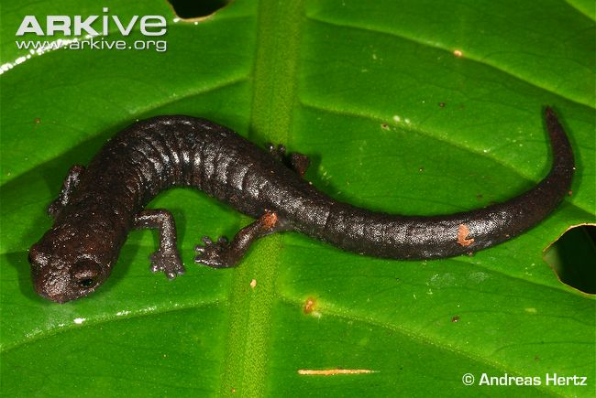
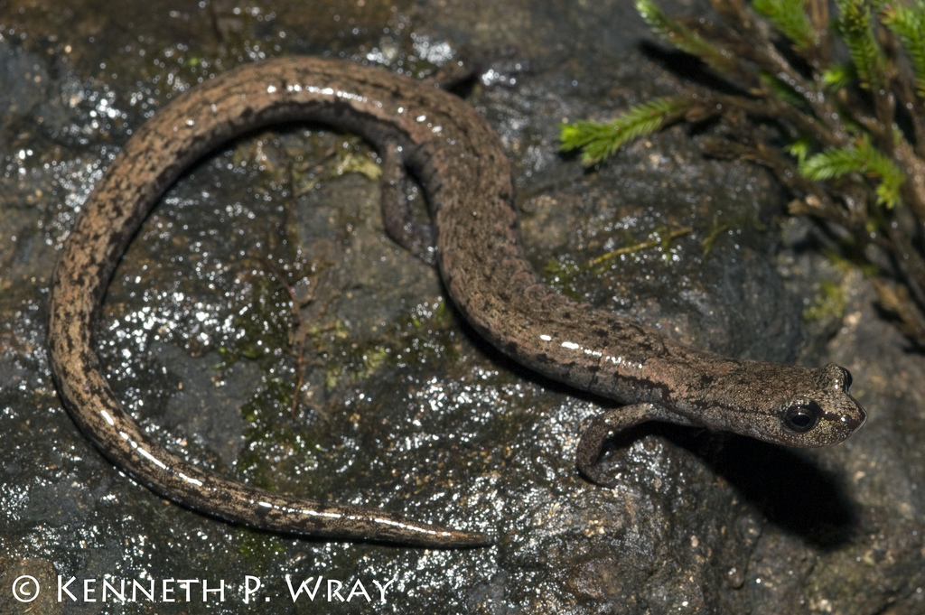
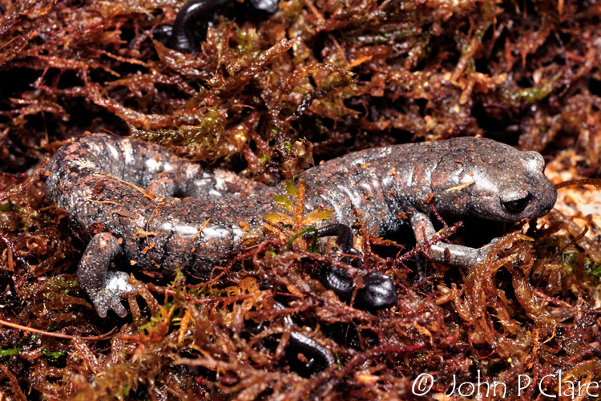
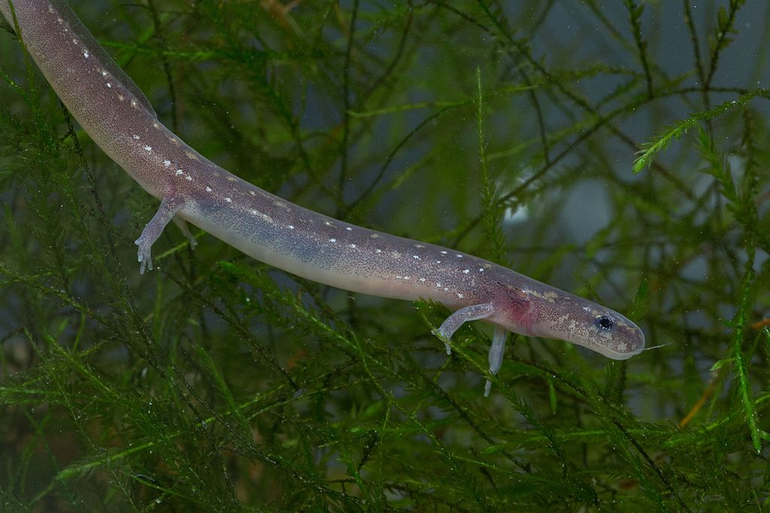
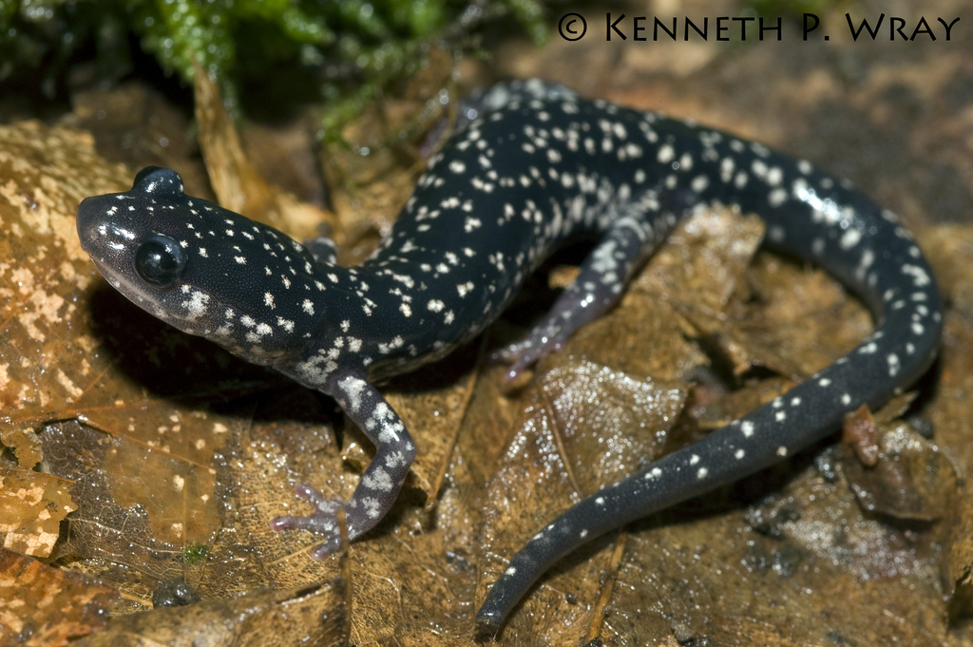
Notes:
Bolitoglossa sombra – arboreal
Batrachoseps stebbinsi – saxicolous
Aquiloeurycea galeanae – terrestrial
Plethodon kentucki – fossorial
Eurycea nana– aquatic

Slide 6
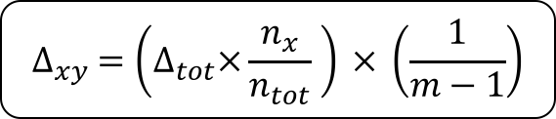
$$∆_{xy} =\left(∆_{tot}×\frac{n_{x}}{n_{tot}} \right) × \left(\frac{1}{m−1}\right)$$
Observed
 | A | F | S | T | Aq
A |  | 0 | 1.80 | 7.07 | 0
F | 0 |  | 0.12 | 0.92 | 0
S | 0 | 2.37 |  | 1.18 | 0.18
T | 29.85 | 19.00 | 15.81 |  | 7.17
Aq | 0 | 1 | 2.00 | 1.86
NULL
 | A | F | S | T | Aq
A |  | 3.81 | 3.81 | 3.81 | 3.81
F | 1.97 |  | 1.97 | 1.97 | 1.97
S | 2.25 | 2.25 |  | 2.25 | 2.25
T | 11.63 | 11.63 | 11.63 |  | 11.63
Aq | 2.92 | 2.92 | 2.92 | 2.92

Slide 7
Observed
 | A | F | S | T | Aq
A |  | 0 | 1.80 | 7.07 | 0
F | 0 |  | 0.12 | 0.92 | 0
S | 0 | 2.37 |  | 1.18 | 0.18
T | 29.85 | 19.00 | 15.81 |  | 7.17
Aq | 0 | 1 | 2.00 | 1.86
NULL
 | A | F | S | T | Aq
A |  | 3.81 | 3.81 | 3.81 | 3.81
F | 1.97 |  | 1.97 | 1.97 | 1.97
S | 2.25 | 2.25 |  | 2.25 | 2.25
T | 11.63 | 11.63 | 11.63 |  | 11.63
Aq | 2.92 | 2.92 | 2.92 | 2.92
Overall: p < 0.001*
TO Arb: p < 0.001*
FROM Arb: p = 0.009*

Slide 8
Stochastic Mapping
 | A | F | S | T | Aq
A |  | 0 | 1.91 | 23.04 | 0
F | 0 |  | 12.00 | 8.25 | 0
S | 0.30 | 10.92 |  | 5.71 | 2.44
T | 32.85 | 16.87 | 15.31 |  | 7.81
Aq | 0 | 0 | 4.71 | 2.11
Majority Rule
 | A | F | S | T | Aq
A |  | 0 | 1.80 | 7.07 | 0
F | 0 |  | 0.12 | 0.92 | 0
S | 0 | 2.37 |  | 1.18 | 0.18
T | 29.85 | 19.00 | 15.81 |  | 7.17
Aq | 0 | 1 | 2.00 | 1.86
NULL
 | A | F | S | T | Aq
A |  | 6.08 | 6.08 | 6.08 | 6.08
F | 3.15 |  | 3.15 | 3.15 | 3.15
S | 3.58 | 3.58 |  | 3.58 | 3.58
T | 18.57 | 18.57 | 18.57 |  | 18.57
Aq | 4.67 | 4.67 | 4.67 | 4.67
NULL
 | A | F | S | T | Aq
A |  | 3.81 | 3.81 | 3.81 | 3.81
F | 1.97 |  | 1.97 | 1.97 | 1.97
S | 2.25 | 2.25 |  | 2.25 | 2.25
T | 11.63 | 11.63 | 11.63 |  | 11.63
Aq | 2.92 | 2.92 | 2.92 | 2.92

